Slide 1


CS 161: Fundamentals of Artificial Intelligence
Constraint Satisfaction Problems
University of California Los Angeles

Slide 2


What is Search For?
Assumptions about the world: a single agent, deterministic actions, fully observed state, discrete state space
Planning: sequences of actions
The path to the goal is the important thing
Paths have various costs, depths
Heuristics give problem-specific guidance
Identification: assignments to variables
The goal itself is important, not the path
All paths at the same depth (for some formulations)
CSPs are specialized for identification problems

Slide 3

Constraint Satisfaction Problems

Slide 4


Constraint Satisfaction Problems
Standard search problems:
State is a “black box”: arbitrary data structure
Goal test can be any function over states
Successor function can also be anything
Constraint satisfaction problems (CSPs):
A special subset of search problems
State is defined by variables X_{i} with values from a domain D (sometimes D depends on i)
Goal test is a set of constraints specifying allowable combinations of values for subsets of variables
Simple example of a formal representation language
Allows useful general-purpose algorithms with more power than standard search algorithms
Notes:
Goal test has structure, it ‘s more like a manual describing a set of constraints that have to hold true

Slide 5
CSP Examples

Slide 6


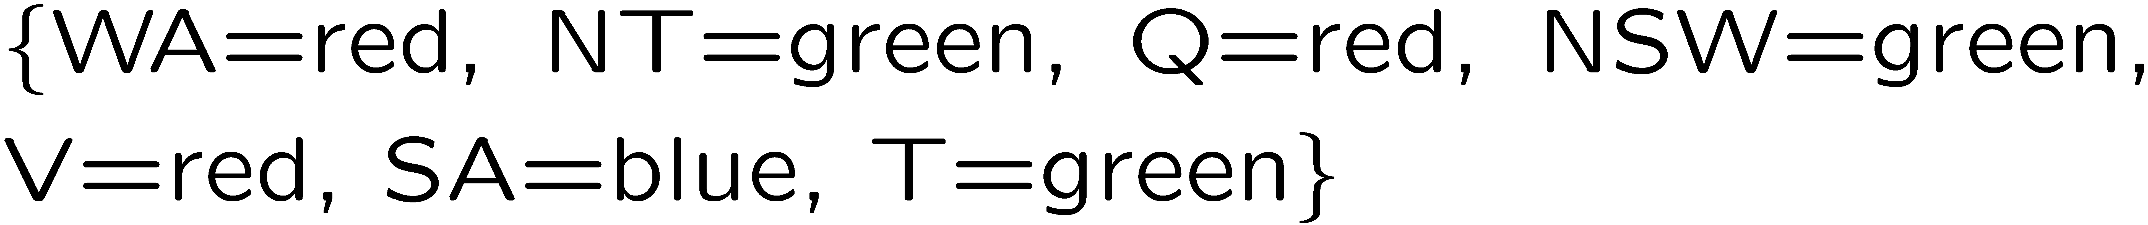
Example: Map Coloring
Variables:
Domains:
Constraints: adjacent regions must have different colors
Solutions are assignments satisfying all constraints, e.g.:
Implicit:
Explicit:

Slide 7
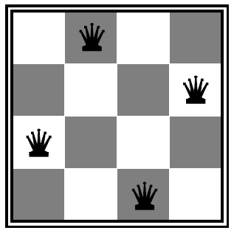

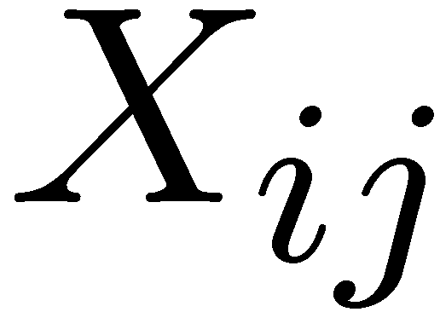

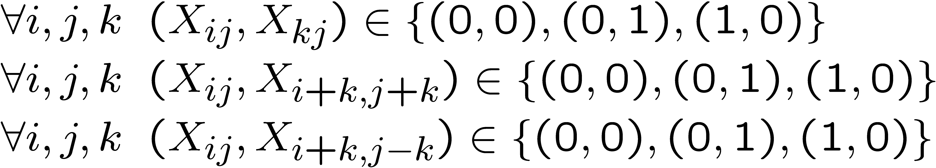
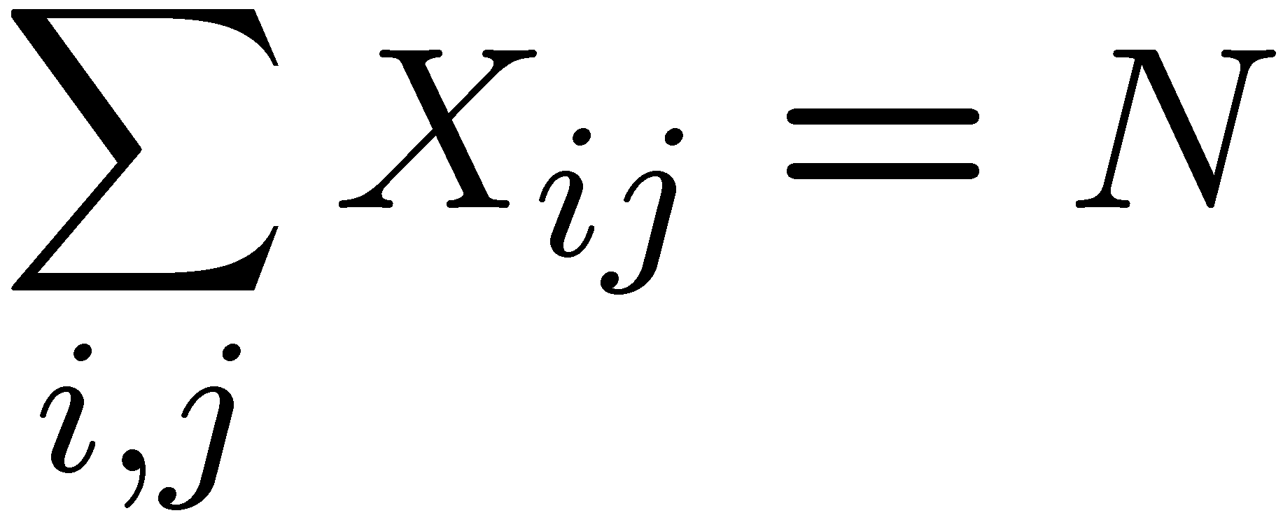
Example: N-Queens
Formulation 1:
Variables:
Domains:
Constraints

Slide 8







Example: N-Queens
Formulation 2:
Variables:
Domains:
Constraints:
Implicit:
Explicit:

Slide 9
Constraint Graphs

Slide 10
Constraint Graphs
Binary CSP: each constraint relates (at most) two variables
Binary constraint graph: nodes are variables, arcs show constraints
General-purpose CSP algorithms use the graph structure to speed up search. E.g., Tasmania is an independent sub-problem!
Notes:
Demo:
Run constraint.jar or constraint.exe, load the 5 queens problem.
Demo is just showing the n-queens applet as illustration of constraint graph, but later in lecture we’ll interact with the applet.
aispace.org will have the latest version

Slide 11


Example: Cryptarithmetic
Variables:
Domains:
Constraints:
Notes:
0=7, R=4, W=6, U=2, T=8, F=1; 867 + 867 = 1734

Slide 12
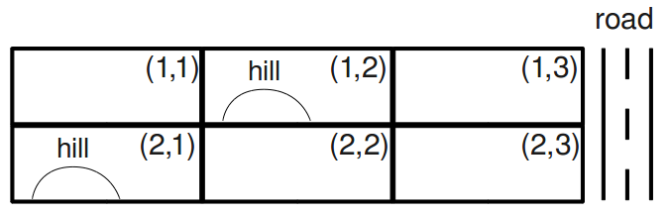
Exercise: Campus Layout
You are asked to determine the layout of a new, small college. The campus will have four structures: an administration structure (A), a bus stop (B), a classroom (C), and a dormitory (D). Each structure (including the bus stop) must be placed somewhere on the grid shown below.
The layout must satisfy the following constraints:
The bus stop (B) must be adjacent to the road.
The administration structure (A) and the classroom (C) must both be adjacent to the bus stop (B).
The classroom (C) must be adjacent to the dormitory (D).
The administration structure (A) must not be adjacent to the dormitory (D).
The administration structure (A) must not be on a hill.
The dormitory (D) must be on a hill or adjacent to the road.
All structures must be in different grid squares.
(Here, adjacent means that the structures must share a grid edge, not just a corner.)
Q1: Which of the constraints are unary constraints?

Slide 13

Varieties of CSPs and Constraints

Slide 14


Varieties of CSPs
Discrete Variables
Finite domains
Size d means O(d^{n}) complete assignments
E.g., Boolean CSPs, including Boolean satisfiability (NP-complete)
Infinite domains (integers, strings, etc.)
E.g., job scheduling, variables are start/end times for each job
Linear constraints solvable, nonlinear undecidable
Continuous variables
E.g., start/end times for Hubble Telescope observations
Linear constraints solvable in polynomial time by LP methods (see cs170 for a bit of this theory)

Slide 15


Varieties of Constraints
Varieties of Constraints
Unary constraints involve a single variable (equivalent to reducing domains), e.g.:
Binary constraints involve pairs of variables, e.g.:
Higher-order constraints involve 3 or more variables:
e.g., cryptarithmetic column constraints
Preferences (soft constraints):
E.g., red is better than green
Often representable by a cost for each variable assignment
Gives constrained optimization problems
(We’ll ignore these until we get to Bayes’ nets)

Slide 16
Exercise: Campus Layout
You are asked to determine the layout of a new, small college. The campus will have four structures: an administration structure (A), a bus stop (B), a classroom (C), and a dormitory (D). Each structure (including the bus stop) must be placed somewhere on the grid shown below.
The layout must satisfy the following constraints:
The bus stop (B) must be adjacent to the road.
The administration structure (A) and the classroom (C) must both be adjacent to the bus stop (B).
The classroom (C) must be adjacent to the dormitory (D).
The administration structure (A) must not be adjacent to the dormitory (D).
The administration structure (A) must not be on a hill.
The dormitory (D) must be on a hill or adjacent to the road.
All structures must be in different grid squares.
(Here, adjacent means that the structures must share a grid edge, not just a corner.)
Q1: Which of the constraints are unary constraints?

Slide 17
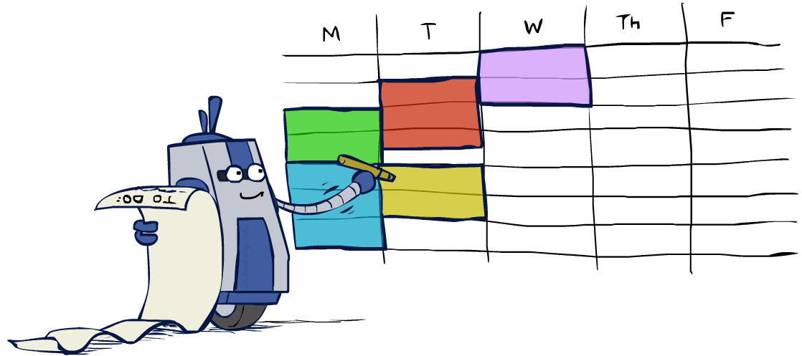
Real-World CSPs
Assignment problems: e.g., who teaches what class
Timetabling problems: e.g., which class is offered when and where?
Hardware configuration
Transportation scheduling
Factory scheduling
Circuit layout
Fault diagnosis
… lots more!
Many real-world problems involve real-valued variables…

Slide 18

Solving CSPs

Slide 19
Standard Search Formulation
Standard search formulation of CSPs
States defined by the values assigned so far (partial assignments)
Initial state: the empty assignment, {}
Successor function: assign a value to an unassigned variable
Goal test: the current assignment is complete and satisfies all constraints
We’ll start with the straightforward, naïve approach, then improve it

Slide 20
Search Methods
What would BFS do?
What would DFS do?
What problems does naïve search have?
Notes:
Demo:
CS188 javascript demos -> source -> exercises -> csps -> CSPs demos -> CSPs demos.html
Settings:
Graph = Simple
Algorithm = Naïve Search
Ordering = None
Filtering = None

Slide 21

Backtracking Search

Slide 22
Backtracking Search
Backtracking search is the basic uninformed algorithm for solving CSPs
Idea 1: One variable at a time
Variable assignments are commutative, so fix ordering
I.e., [WA = red then NT = green] same as [NT = green then WA = red]
Only need to consider assignments to a single variable at each step
Idea 2: Check constraints as you go
I.e. consider only values which do not conflict previous assignments
Might have to do some computation to check the constraints
“Incremental goal test”
Depth-first search with these two improvements
is called backtracking search (not the best name)
Can solve n-queens for n ≈ 25

Slide 23
Backtracking Example

Slide 24
Exercise: Campus Layout Part 1: type of constraints
You are asked to determine the layout of a new, small college. The campus will have four structures: an administration structure (A), a bus stop (B), a classroom (C), and a dormitory (D). Each structure (including the bus stop) must be placed somewhere on the grid shown below.
The layout must satisfy the following constraints:
The bus stop (B) must be adjacent to the road.
The administration structure (A) and the classroom (C) must both be adjacent to the bus stop (B).
The classroom (C) must be adjacent to the dormitory (D).
The administration structure (A) must not be adjacent to the dormitory (D).
The administration structure (A) must not be on a hill.
The dormitory (D) must be on a hill or adjacent to the road.
All structures must be in different grid squares.
(Here, adjacent means that the structures must share a grid edge, not just a corner.)
Q1: Which of the constraints are unary constraints?

Slide 25
Select the domains of all variables after unary constraints have been applied.
The bus stop (B) must be adjacent to the road.
The administration structure (A) must not be on a hill.
The dormitory (D) must be on a hill or adjacent to the road.
A | B | C | D
(1, 1) | (1, 1) | (1, 1) | (1, 1)
(1, 2) | (1, 2) | (1, 2) | (1, 2)
(1, 3) | (1, 3) | (1, 3) | (1, 3)
(2, 1) | (2, 1) | (2, 1) | (2, 1)
(2, 2) | (2, 2) | (2, 2) | (2, 2)
(2, 3) | (2, 3) | (2, 3) | (2, 3)

Slide 26
Backtracking Search
Backtracking = DFS + variable-ordering + fail-on-violation
What are the choice points?
Notes:
Demo:
CS188 javascript demos -> source -> exercises -> csps -> CSPs demos -> CSPs demos.html
Settings:
Graph = Simple
Algorithm = Backtracking
Ordering = None
Filtering = None

Slide 27

Improving Backtracking
General-purpose ideas give huge gains in speed
Ordering:
Which variable should be assigned next?
In what order should its values be tried?
Filtering: Can we detect inevitable failure early?
Structure: Can we exploit the problem structure?

Slide 28

Filtering

Slide 29
Filtering: Forward Checking
Filtering: Keep track of domains for unassigned variables and cross off bad options
Forward checking: Cross off values that violate a constraint when added to the existing assignment
WA
NT
Q
SA
NSW
V
Notes:
Demo:
CS188 javascript demos -> source -> exercises -> csps -> CSPs demos -> CSPs demos.html
Settings:
Graph = Simple
Algorithm = Backtracking
Ordering = None
Filtering = Forward Checking

Slide 30
Filtering: Constraint Propagation
Forward checking propagates information from assigned to unassigned variables, but doesn't provide early detection for all failures:
NT and SA cannot both be blue!
Why didn’t we detect this yet?
Constraint propagation: reason from constraint to constraint
NT
Q
WA
SA
NSW
V

Slide 31

Consistency of A Single Arc
An arc X → Y is consistent iff for every x in the tail there is some y in the head which could be assigned without violating a constraint
Forward checking: Enforcing consistency of arcs pointing to each new assignment
NT
Q
WA
SA
NSW
V
Delete from the tail!

Slide 32
Arc Consistency of an Entire CSP
A simple form of propagation makes sure all arcs are consistent:
Important: If X loses a value, neighbors of X need to be rechecked!
Arc consistency detects failure earlier than forward checking
Can be run as a preprocessor or after each assignment
What’s the downside of enforcing arc consistency?
NT
Q
WA
SA
NSW
V
Remember: Delete from the tail!

Slide 33
Exercise: Campus Layout Part 2: Arc Consistency
You are asked to determine the layout of a new, small college. The campus will have four structures: an administration structure (A), a bus stop (B), a classroom (C), and a dormitory (D). Each structure (including the bus stop) must be placed somewhere on the grid shown below.
The layout must satisfy the following constraints:
The bus stop (B) must be adjacent to the road.
The administration structure (A) and the classroom (C) must both be adjacent to the bus stop (B).
The classroom (C) must be adjacent to the dormitory (D).
The administration structure (A) must not be adjacent to the dormitory (D).
The administration structure (A) must not be on a hill.
The dormitory (D) must be on a hill or adjacent to the road.
All structures must be in different grid squares.
(Here, adjacent means that the structures must share a grid edge, not just a corner.)

Slide 34
Exercise: Campus Layout Part 2: Arc Consistency
Let's start from the previous table in the answer to Part 1, and enforce arc consistency. Initially, the queue contains all arcs (in alphabetical order).
Let's examine what happens when enforcing A → B. After enforcing unary constraints, the domains of A and B are:
Q2: Which of the following contains the correct domains after enforcing A → B? Pay attention to which variable's domain changes and which side of the arc it's on.
A | B
(1, 1)
(1, 3) | (1, 3)
(2, 2)
(2, 3) | (2, 3)
A | B
(1, 1)
 | (1, 2)
(1, 3) | (1, 3)
(2, 2)
(2, 3) | (2, 3)
A | B
(1, 3) | (1, 3)
(2, 2)
(2, 3) | (2, 3)
A | B
(1, 1)
(1, 3)
(2, 2)
(2, 3) | (2, 3)
A | B
(1, 1)
(1, 3) | (1, 3)
(2, 2)
(2, 3)
Notes:
After an arc is enforced, every value in the domain of the tail has at least one possible value in the domain of the head such that the two values satisfy all constraints with each other. If a value in the tail's domain does not satisfy this, that value can be removed, because it is guaranteed not to be a part of a solution without backtracking on some previously selected variable. In this case, (1,1) in A's domain is not adjacent to either (1,3) or (2,3), so B has no possible values and (1,1) can be removed from A's domain.

Slide 35
Exercise: Campus Layout Part 2: Arc Consistency
Q3: Starting from the answer to Part 1 (in which unary constraints are enforced), select the domains of all variables after A → B is enforced.
A | B | C | D
(1, 1) | (1, 1) | (1, 1) | (1, 1)
(1, 2) | (1, 2) | (1, 2) | (1, 2)
(1, 3) | (1, 3) | (1, 3) | (1, 3)
(2, 1) | (2, 1) | (2, 1) | (2, 1)
(2, 2) | (2, 2) | (2, 2) | (2, 2)
(2, 3) | (2, 3) | (2, 3) | (2, 3)
Notes:
These are the same as part 1, except with (1,1) removed from A's domain due to enforcing A->B.

Slide 36
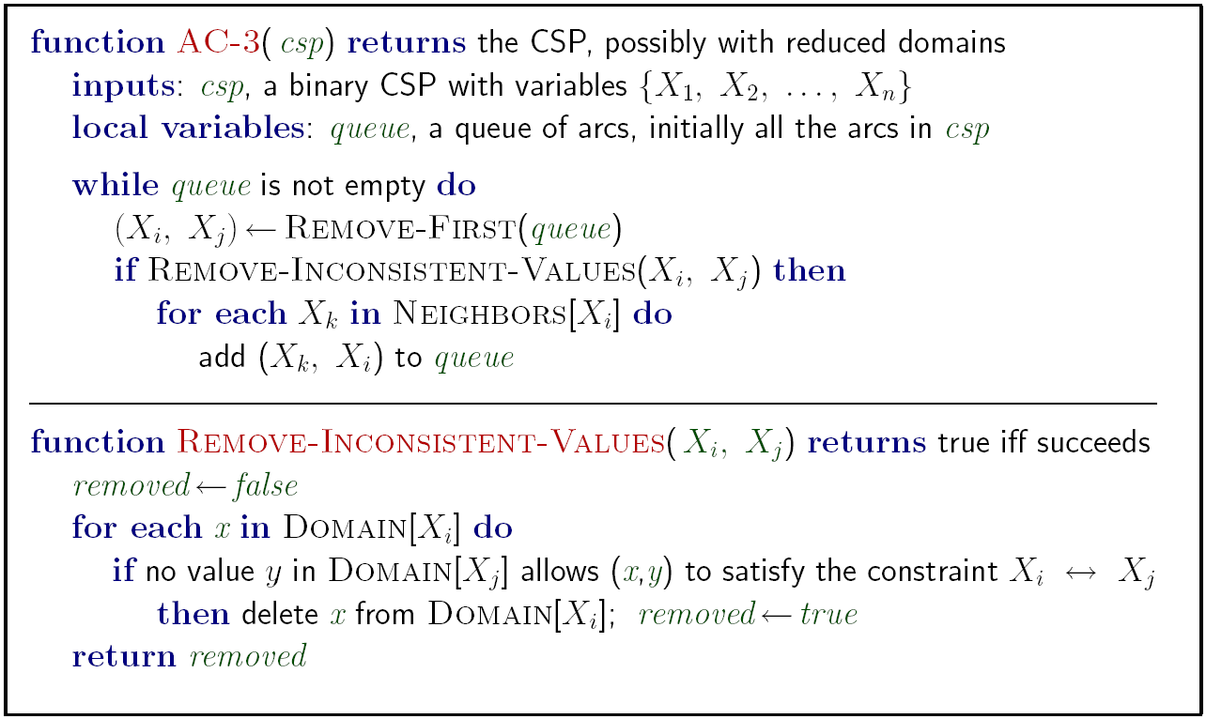
Enforcing Arc Consistency in a CSP
Runtime: O(n²d³), can be reduced to O(n²d²)
… but detecting all possible future problems is NP-hard – why?
Notes:
Auto-consistency (note initially nothing gets deleted/pruned since there are consistent options for all constraints for initial variable domains)
Flashes whenever something needs to be re-checked

Slide 37
Exercise: Campus Layout Part 2: Arc Consistency
Q4: You should verify that enforcing consistency for A → C, A → D, B → A, B → C, B → D, and C → A do not change the domains of any variables. After enforcing these arcs, the next is C → B.
Continuing from the previous parts, select the domains of all variables after C → B is enforced.
A | B | C | D
(1, 1) | (1, 1) | (1, 1) | (1, 1)
(1, 2) | (1, 2) | (1, 2) | (1, 2)
(1, 3) | (1, 3) | (1, 3) | (1, 3)
(2, 1) | (2, 1) | (2, 1) | (2, 1)
(2, 2) | (2, 2) | (2, 2) | (2, 2)
(2, 3) | (2, 3) | (2, 3) | (2, 3)
Notes:
(1,1) and (2,1) are removed from C, because if either value is assigned to C, there is no possible value in B's domain that satisfies all of the constraints. A and D's domains do not change.

Slide 38
Exercise: Campus Layout Part 2: Arc Consistency
Q5 What arcs got added to the queue while enforcing C → B? Remember that the queue contained C → D, D → A, D → B, and D → C prior to enforcing C → B.
A → B
A → C
A → D
B → A
B → C
B → D
C → A
C → B
C → D
D → A
D → B
D → C
None
Notes:
When a domain changes after enforcing an arc, all arcs that end at that variable must be re-added to the queue: A→C, B→C. This is done because some values in other variables' domains might have relied on the removed values to be consistent, so they have to be checked again.

Slide 39
Exercise: Campus Layout Part 2: Arc Consistency
Q6: Continuing from the previous parts, select the domains of all variables after enforcing arc consistency until the queue is empty. Remember that the queue currently contains C → D, D → A, D → B, D → C, and any arcs that were added while enforcing C → B.
A | B | C | D
(1, 1) | (1, 1) | (1, 1) | (1, 1)
(1, 2) | (1, 2) | (1, 2) | (1, 2)
(1, 3) | (1, 3) | (1, 3) | (1, 3)
(2, 1) | (2, 1) | (2, 1) | (2, 1)
(2, 2) | (2, 2) | (2, 2) | (2, 2)
(2, 3) | (2, 3) | (2, 3) | (2, 3)
Notes:
Repeat the same process as parts c and e above for each arc in the queue. In this case the only value that gets removed from any domain while enforcing the arcs is (2,3) from D due to enforcing D→A.

Slide 40
Limitations of Arc Consistency
After enforcing arc consistency:
Can have one solution left
Can have multiple solutions left
Can have no solutions left (and not know it)
Arc consistency still runs inside a backtracking search!
What went wrong here?
Notes:
Demo:
CS188 javascript demos -> source -> exercises -> csps -> CSPs demos -> CSPs demos.html
Settings:
Graph = Complex
Algorithm = Backtracking
Ordering = None
Filtering = Forward Checking (first) / Arc Consistency (second)

Slide 41

Ordering

Slide 42
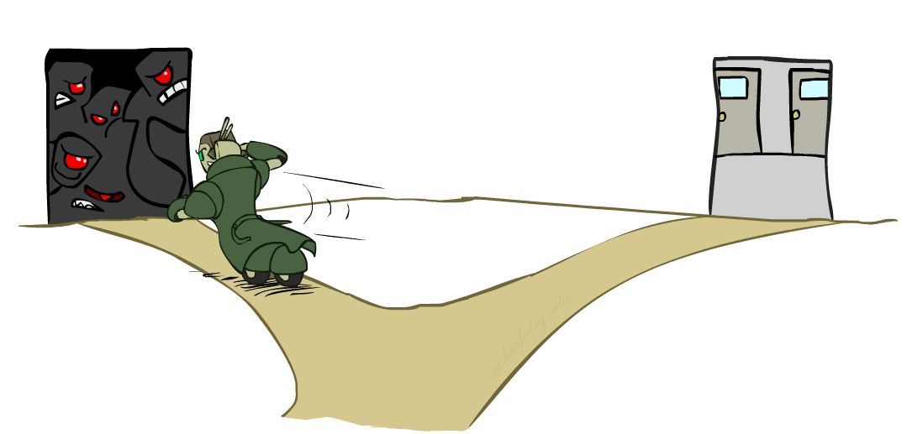
Ordering: Minimum Remaining Values
Variable Ordering: Minimum remaining values (MRV):
Choose the variable with the fewest legal left values in its domain
Why min rather than max?
Also called “most constrained variable”
“Fail-fast” ordering

Slide 43
Exercise: Campus Layout Part 2: Arc Consistency
Q7: If arc consistency had resulted in all domains having a single value left, we would have already found a solution. Similarly, if it had found that any domain had no values left, we would have already found that no solution exists. Unfortunately, this is not the case in our example (as you should have found in the previous part). To solve the problem, we need to start searching. Use the MRV (minimum remaining values) heuristic to choose which variable gets assigned next (breaking any ties alphabetically). Which variable gets assigned next?
A B C D
Notes:
B only has 2 possible values, while A and D have 3, and C has 4.

Slide 44
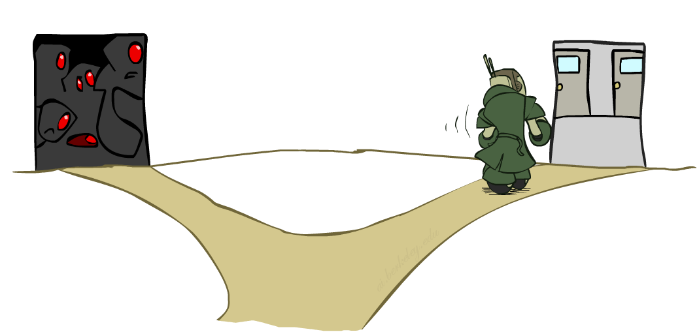
Ordering: Least Constraining Value
Value Ordering: Least Constraining Value
Given a choice of variable, choose the least constraining value
I.e., the one that rules out the fewest values in the remaining variables
Note that it may take some computation to determine this! (E.g., rerunning filtering)
Why least rather than most?
Combining these ordering ideas makes
1000 queens feasible

Slide 45
Exercise: Campus Layout Part 2: Arc Consistency
Q8: The variable you selected should have two values left in its domain. We will use the least-constraining value (LCV) heuristic to decide which value to assign before continuing with the search. To choose which value is the least-constraining value, enforce arc consistency for each value (on a scratch piece of paper). For each value, count the total number of values remaining over all variables.
Which value has the largest number of values remaining (and therefore is the least constraining value)?
(1,1)
(1,2)
(1,3)
(2,1)
(2,2)
(2,3)
Notes:
Assigning (1,3) to B leaves only 2 other values: A or D with value (2,3) and C with value (1,2). Assigning (2,3) to B leaves 3 other values: A with value (1,3), C with value (2,2) and D with value (2,1) Since 3 > 2, (2,3) is the least constraining value.

Slide 46
After assigning a variable, backtracking search with arc consistency enforces arc consistency before proceeding to the next variable.
Select the domains of all variables after assignment of the least-constraining value to the variable you selected and enforcing arc consistency. Note that you already did this computation to determine which value was the LCV.
A | B | C | D
(1, 1) | (1, 1) | (1, 1) | (1, 1)
(1, 2) | (1, 2) | (1, 2) | (1, 2)
(1, 3) | (1, 3) | (1, 3) | (1, 3)
(2, 1) | (2, 1) | (2, 1) | (2, 1)
(2, 2) | (2, 2) | (2, 2) | (2, 2)
(2, 3) | (2, 3) | (2, 3) | (2, 3)
A | B | C | D
(1, 1) | (1, 1) | (1, 1) | (1, 1)
(1, 2) | (1, 2) | (1, 2) | (1, 2)
(1, 3) | (1, 3) | (1, 3) | (1, 3)
(2, 1) | (2, 1) | (2, 1) | (2, 1)
(2, 2) | (2, 2) | (2, 2) | (2, 2)
(2, 3) | (2, 3) | (2, 3) | (2, 3)

